Slide 1
Credit Risk Analysis
AI Boot Camp Project 2
Team Members:
Anand Bhagwat
Usha Hariharan
Asif Mahmud
Venkat Varun Thamma

Slide 2
Project Overview
Project Purpose / Description
This project showcases the application of machine learning models to analyze and predict borrower credit grades using financial data.
Leveraging advanced datasets and methodologies provides valuable insights to support smarter and more informed lending decisions.

Slide 3
Project Overview
Goals/Problem to be solved
Analyze/ Predict borrower creditworthiness using AI models.
Identify the most impactful features for assessing credit risk.
Compare the performance of multiple models to find the most accurate and efficient.

Slide 4
Project Overview
Overview of data collection process
Kaggle ”Credit Risk Dataset”
Project Sample Size--88,738 entries with 74 columns
Key Attributes:
    Loan Amount (`loan_amnt`)
    Interest Rate (`int_rate`)
    Debt-to-Income Ratio (`dti`)
    Employment Length (`emp_length`)
    Loan Status (`loan_status`)
    Annual Income (`annual_inc`)

Slide 5
Project Overview
Overview of the data cleanup process
Identified columns with null values
Reduced the dataset to only necessary columns
Removed irrelevant columns and handled missing values.
Created new features: `funded_amnt_to_annual_inc` and `revol_bal_to_annual_inc`.
Encoded categorical variables like `term`, `grade`, and `loan_status`
(Insert visual)

Slide 6
Project Overview
Overview of data exploration process
Visualized key feature distributions and their relationships to credit grades.
Examined correlations between variables.

Slide 7
Project Overview
Approach taken to achieve goals
Split data into training and testing sets.
Scaled features using `StandardScaler`.

Slide 9
Project Overview
Approach taken to achieve goals
Trained multiple models
Linear Regression: R² score of 93.3%.
K-Nearest Neighbors (KNN): Best accuracy with k=9 (64.5%).
Random Forest: Testing accuracy of 96.2%.
XGBoost: Overall accuracy of 99%.

Slide 11
Project Overview
Approach taken to achieve goals
Feature Importance:
Identified top predictors such as `int_rate`, `installment`, and `loan amnt’.
Visualized feature importance using horizontal bar plots (next slide)

Slide 12
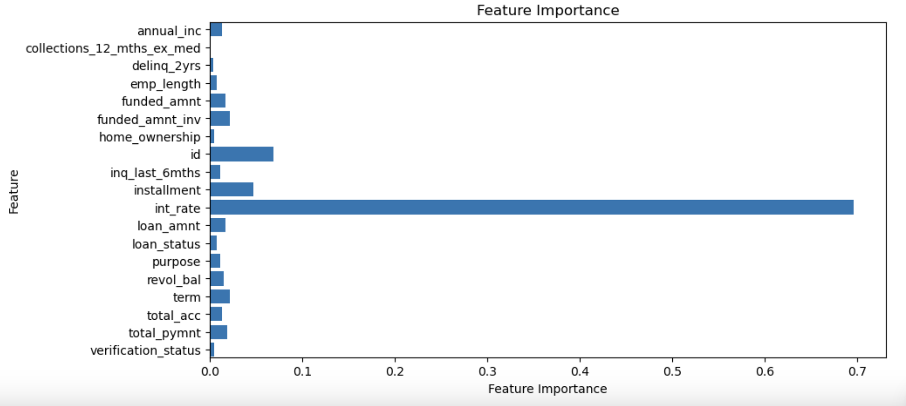

Slide 13
Result/Conclusion 1
Provide a summary of the results with the supporting visualization(s)
**Random Forest**: Testing accuracy: 96.2%.

Slide 14
Result/Conclusion 2
XGBoost**: Precision, Recall, and F1-scores close to 1.0 for all classes.

Slide 15
Result/Conclusion 3
Interest rate (`int_rate`) is the most influential predictor of credit grade.

Slide 16
Summary
First
Second

Slide 17
Problems Encountered
Text

Slide 18

FUTURE FORWARD CREDIT CONSIDERATIONS:
Emerging / alternative data sources: social, connected device data
Environmental/social sustainability metrics: spending pattern alignment with ethical and community welfare practices
Blockchain and decentralized credit scoring: scoring metrics based on smart contracts, blockchain transactions, and wallet activity
Real-time and Dynamic scoring: real-time analysis of transactions and adjustments for critical life events
Ethical and Inclusive models: bias-resistant models, creating nontraditional scoring models that support credit extension to underserved populations
Network-based creditworthiness: peer influence models, group creditworthiness
Hybrid models: FICO+ ML derived alternative data
Future Considerations

Slide 19
FUTURE FORWARD CREDIT CHALLENGES:
Key Challenges to Address
While these paradigms offer tremendous potential, they also present challenges:
Data Privacy and Security: Safeguarding sensitive consumer data.
Fairness and Bias Mitigation: Ensuring equitable access and avoiding systemic bias.
Regulatory Compliance: Aligning innovations with strict regulatory frameworks.
User Trust: Building confidence in nontraditional scoring methods.
Exploring these paradigms in credit risk can revolutionize financial inclusion, improve risk accuracy, and cater to the evolving financial ecosystem.
Future Considerations

